Slide 1
Southern California Hospitality and Service Employment Markets
Chick-fil-A Rancho Cucamonga
External Factors and Labor Research

Slide 2
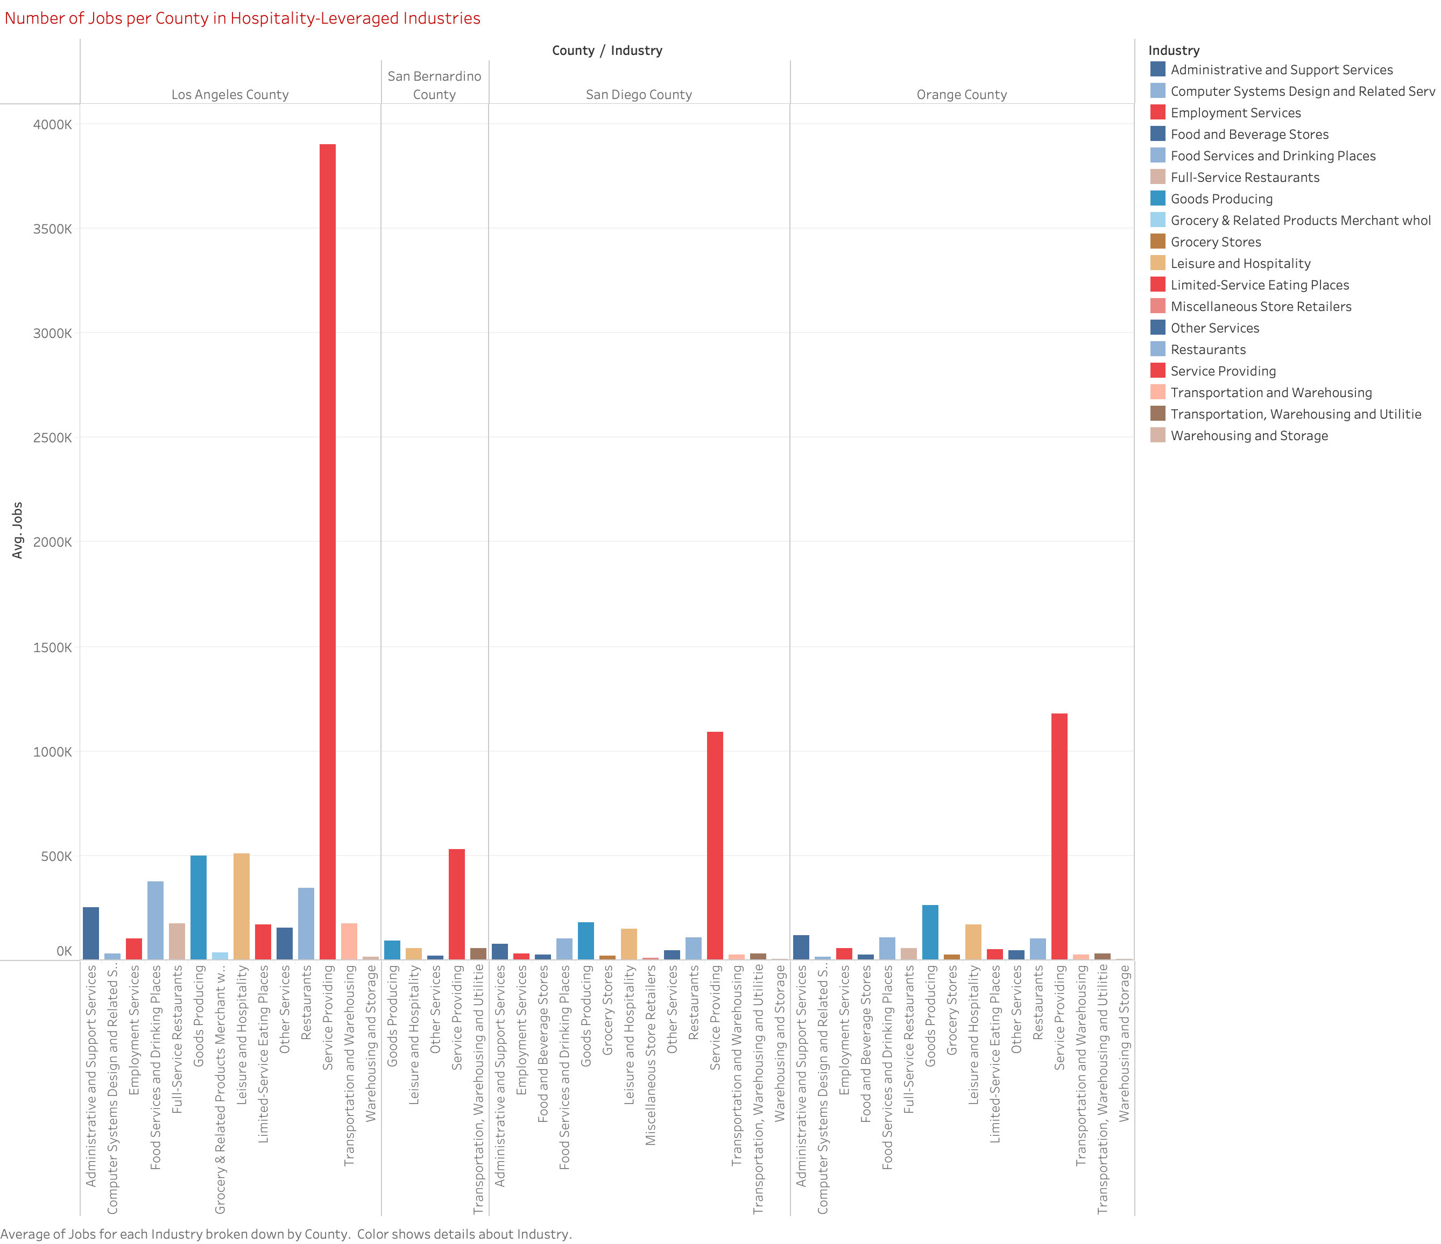

Slide 3
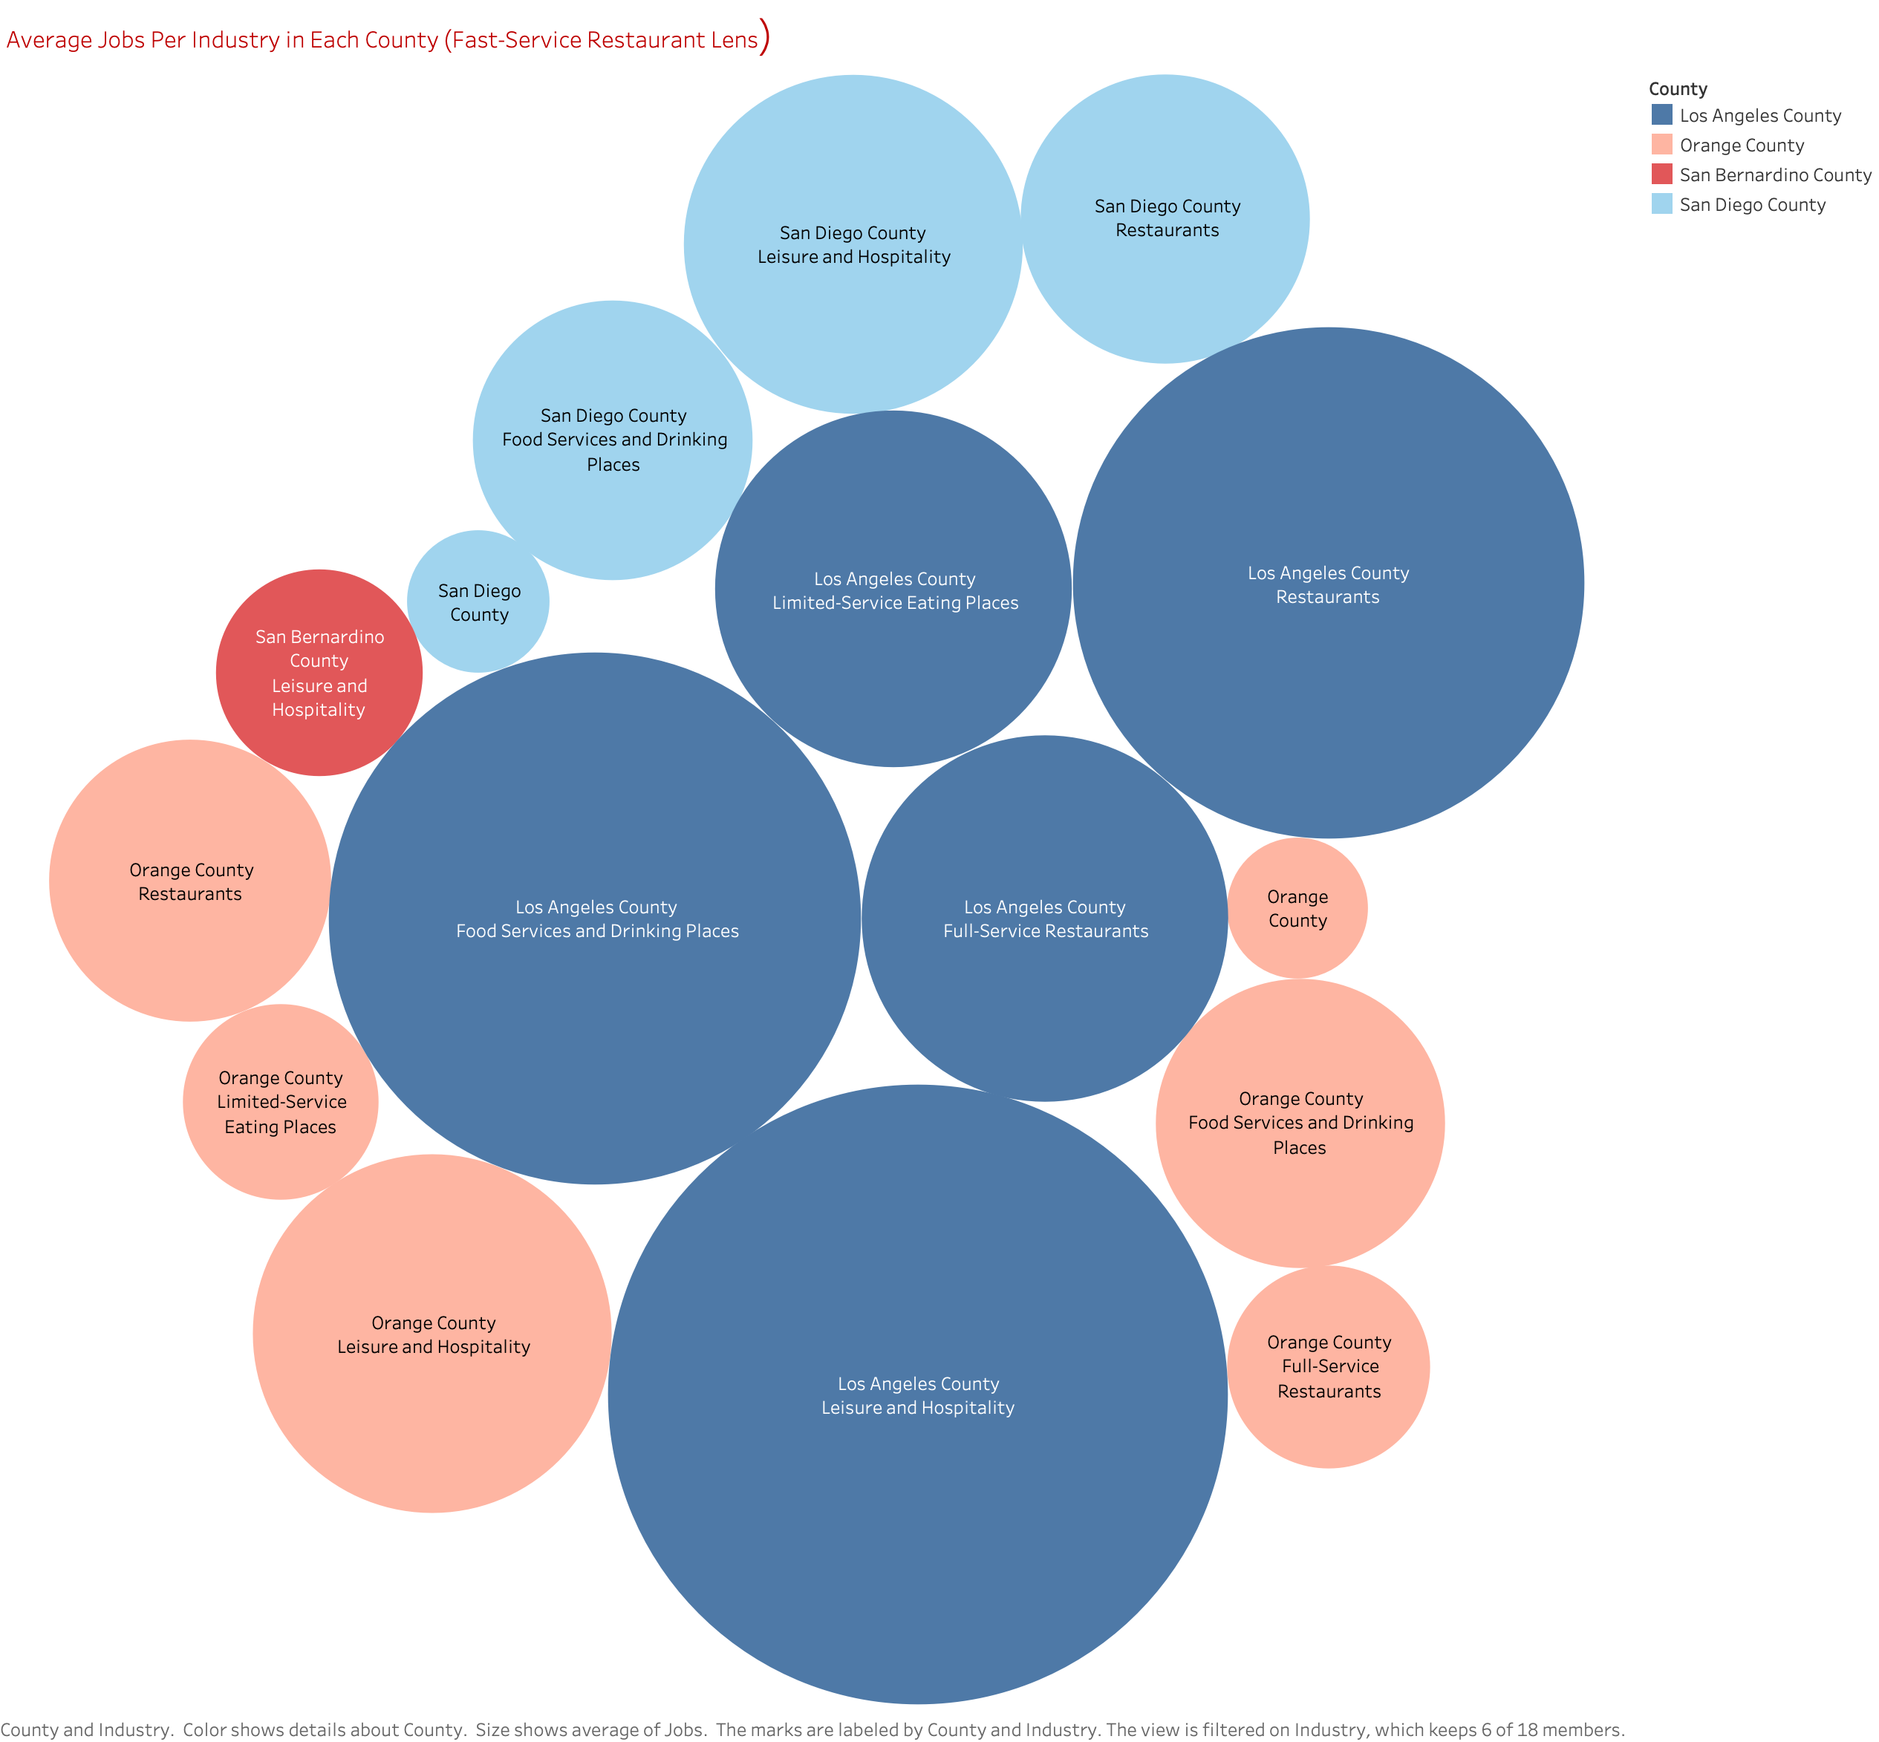

Slide 4
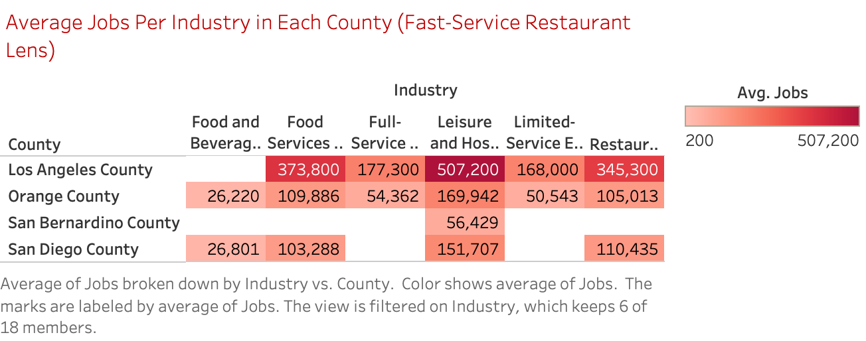

Slide 5
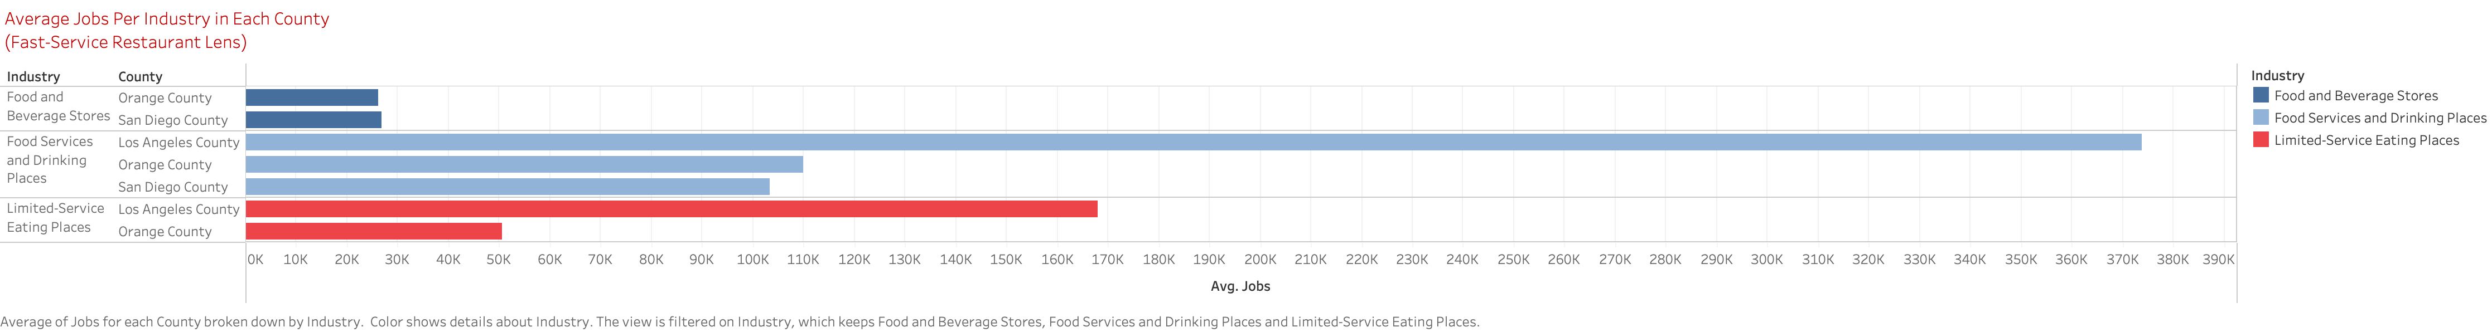

Slide 6
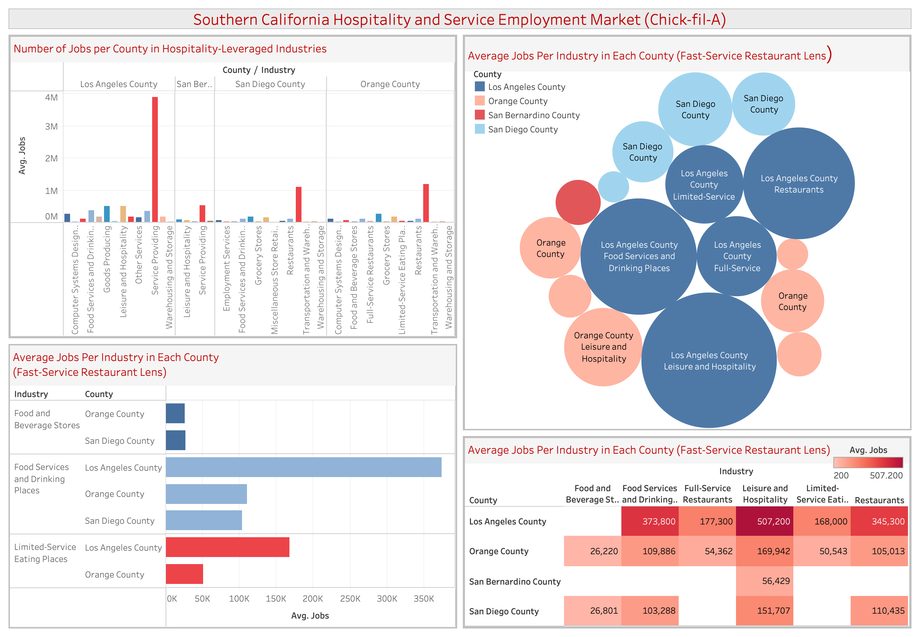

Slide 7
Insights and Recommendation
Given the data analysis conducted on our three main competing markets, (L.A. County, Orange County, San Diego County), there following insights were discovered:
L.A. County’s service industry is the largest of the four markets and offers the most competitive employment pool.
San Bernardino County can benefit by considering the competitive salary packages, hiring process, and talent acquisition that L.A. County offers.
As ”full-service” restaurants like Chick-fil-A continue to grow in popularity, the labor market is catching up in key counties.
Recommendation(s):
Conduct location visits to observe and analyze competing market hiring processes.
Leverage existing mentoring and ”Grand Opening” platform to develop talent internally.
Industry is leaning heavily in our favor; continue investing in ”service-first” training and business strategies (aligned to our KPIs).
Customers continue to value the full-service experience; Great service = increased differential value

